Slide 1

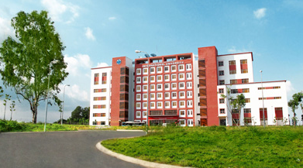
International University
MICRO-PROCESSING SYSTEM
Lecture 9A:
Serial Interface Tutorial
Vo Minh Thanh, M.Eng
School Of Electrical Engineering

Slide 2
Serial Buses in our project
UART serial bus for sending debug messages to your development host
I2C serial bus for communicating with sensors (e.g., the accelerometer)
SPI serial bus for communicating with the Bluetooth Low Energy radio

Slide 3
Serial Interfaces
traps &
exceptions
C
Assembly
Machine Code
CPU
Software
Hardware
SVC#
ldr (read)
str (write)
ISA
fault
INT#
interrupts
System Buses
AHB/APB
Interrupts
GPIO/INT
Timers
USART
DAC/ADC
Internal &
External
Memory
Internal
External
Input
I2C
SPI
ADC
DAC
EMC
Output
Capture
UART
Interrupt
Compare

Slide 4
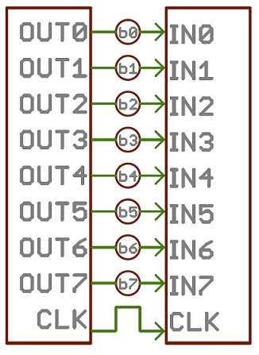
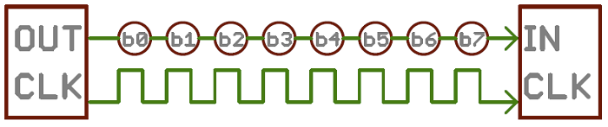
Parallel Bus VS Serial Bus

Slide 5
Simplistic View of Serial Port Operation
Transmitter
Receiver
n
0
1
2
3
4
5
6
7
n
n+1
0
1
2
3
4
5
6
n+1
7
n+2
0
1
2
3
4
5
n+2
6
7
n+3
0
1
2
3
4
n+3
5
6
7
n+4
0
1
2
3
n+4
4
5
6
7
n+5
0
1
2
n+5
3
4
5
6
7
n+6
0
1
n+6
2
3
4
5
6
7
n+7
0
n+7
1
2
3
4
5
6
7
n+8
n+8
0
1
2
3
4
5
6
7
Interrupt raised when
Transmitter (Tx) is empty
a Byte has been transmitted
and next byte ready for loading
Interrupt raised when
Receiver (Rx) is full
a Byte has been received
and is ready for reading
Notes:
5

Slide 6
Serial Bus Interface Motivations
Motivation
Without using a lot of I/O lines
I/O lines require I/O pads which cost $$$ and size
I/O lines require PCB area which costs $$$ and size
Connect different systems together
Two embedded systems
A desktop and an embedded system
Connect different chips together in the same embedded system
MCU to peripheral
MCU to MCU
Often at relatively low data rates
But sometimes at higher data rates
So, what are our options?
Universal Synchronous/Asynchronous Receiver Transmitter
Also known as USART (pronounced: “you-sart”)

Slide 7
Serial Bus Design Space
Number of wires required?
Asynchronous or synchronous?
How fast can it transfer data?
Can it support more than two endpoints?
Can it support more than one master (i.e. txn initiator)?
How do we support flow control?
How does it handle errors/noise?
How far can signals travel?

Slide 8
Serial Bus Examples
 | S/A | Type | Duplex | #Devices | Speed (kbps) | Distance (ft) | Wires
RS232 | A | Peer | Full | 2 | 20 | 30 | 2+
RS422 | A | Multi-drop | Half | 10 | 10000 | 4000 | 1+
RS485 | A | Multi-point | Half | 32 | 10000 | 4000 | 2
I2C | S | Multi-master | Half | ? | 3400 | <10 | 2
SPI | S | Multi-master | Full | ? | >1000 | <10 | 3+
Microwire | S | Master/slave | Full | ? | >625 | <10 | 3+
1-Wire | A | Master/slave | half | ? | 16 | 1000 | 1+

Slide 9
UART Uses
PC serial port is a UART!
Serializes data to be sent over serial cable
De-serializes received data
Slides from BYU CS 224

Slide 10
UART Uses
Used to be commonly used for internet access

Slide 11
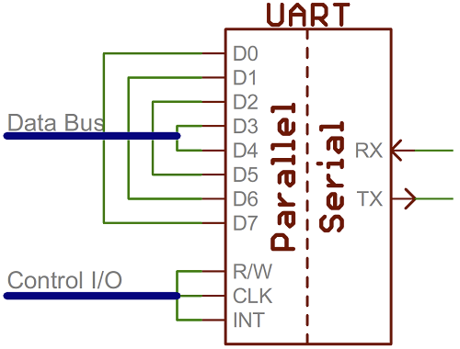
UART
Universal Asynchronous Receiver/Transmitter
Hardware that translates between parallel and serial forms
Commonly used in conjunction with communication standards such as EIA, RS-232, RS-422 or RS-485

Slide 12

Protocol
Each character is sent as
a logic low start bit
a configurable number of data bits (usually 7 or 8, sometimes 5)
an optional parity bit
one or more logic high stop bits
with a particular bit timing (“baud”)

Slide 13
UART Example
Send the ASCII letter ‘W’ (1010111)

Slide 14
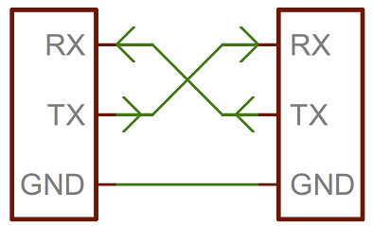
UART Hardware Connection

Slide 15
UART Character Reception

Slide 16
UART Character Reception

Slide 17
UART Character Reception

Slide 18
UART Character Reception
Receiver also verifies that stop bit is ‘1’
If not, reports “framing error” to host system
New start bit can appear immediately after stop bit
Receiver will resynchronize on each start bit

Slide 19
Let us design a UART transmitter

Slide 20
Transmitter/System Handshaking
System asserts Send and holds it high when it wants to send a byte
UART asserts Busy signal in response
When UART has finished transfer, UART de-asserts Busy signal
System de-asserts Send signal

Slide 21
Transmitter Block Diagram

Slide 22
Discussion Questions
How fast can we run a UART?
What are the limitations?
Why do we need start/stop bits?
How many data bits can be sent?
19200 baud rate, no parity, 8 data bits, 1 stop bit

Slide 23
Serial Peripheral Interconnect (SPI)
Another kind of serial protocol in embedded systems (proposed by Motorola)
Four-wire protocol
SCLK — Serial Clock
MOSI/SIMO — Master Output, Slave Input
MISO/SOMI — Master Input, Slave Output
SS — Slave Select
Single master device and with one or more slave devices
Higher throughput than I2C and can do “stream transfers”
No arbitration required
But
Requires more pins
Has no hardware flow control
No slave acknowledgment (master could be talking to thin air and not even know it)
Notes:
Better suited for “data streams”, i.e. ADC converters
Full duplex capability, i.e. communication between a codec and digital signal processor

Slide 24
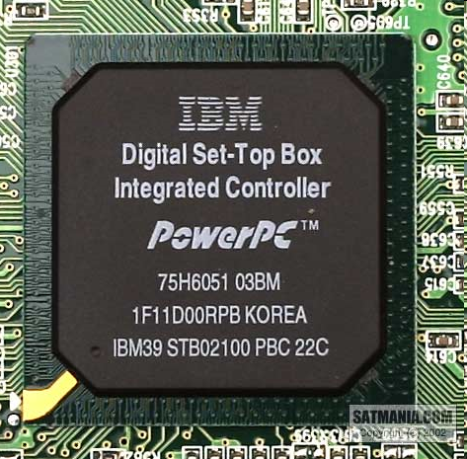
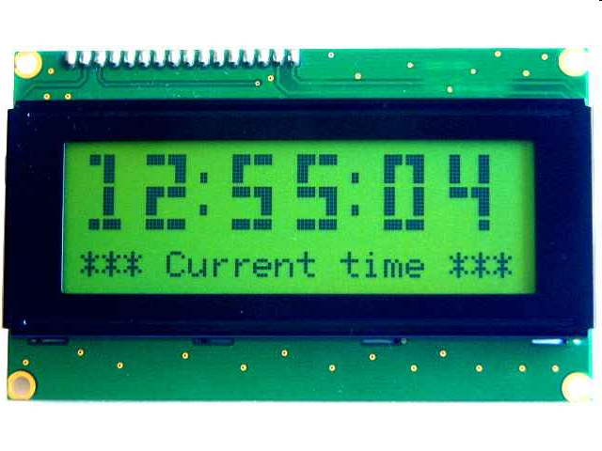
What is SPI?
Serial Bus protocol
Fast, Easy to use, Simple
Everyone supports it

Slide 25
SPI Basics
A communication protocol using 4 wires
Also known as a 4 wire bus
Used to communicate across small distances
Multiple Slaves, Single Master
Synchronized

Slide 26
SPI Capabilities
Always Full Duplex
Communicating in two directions at the same time
Transmission need not be meaningful
Multiple Mbps transmission speed
Transfers data in 4 to 16 bit characters
Multiple slaves
Daisy-chaining possible

Slide 27
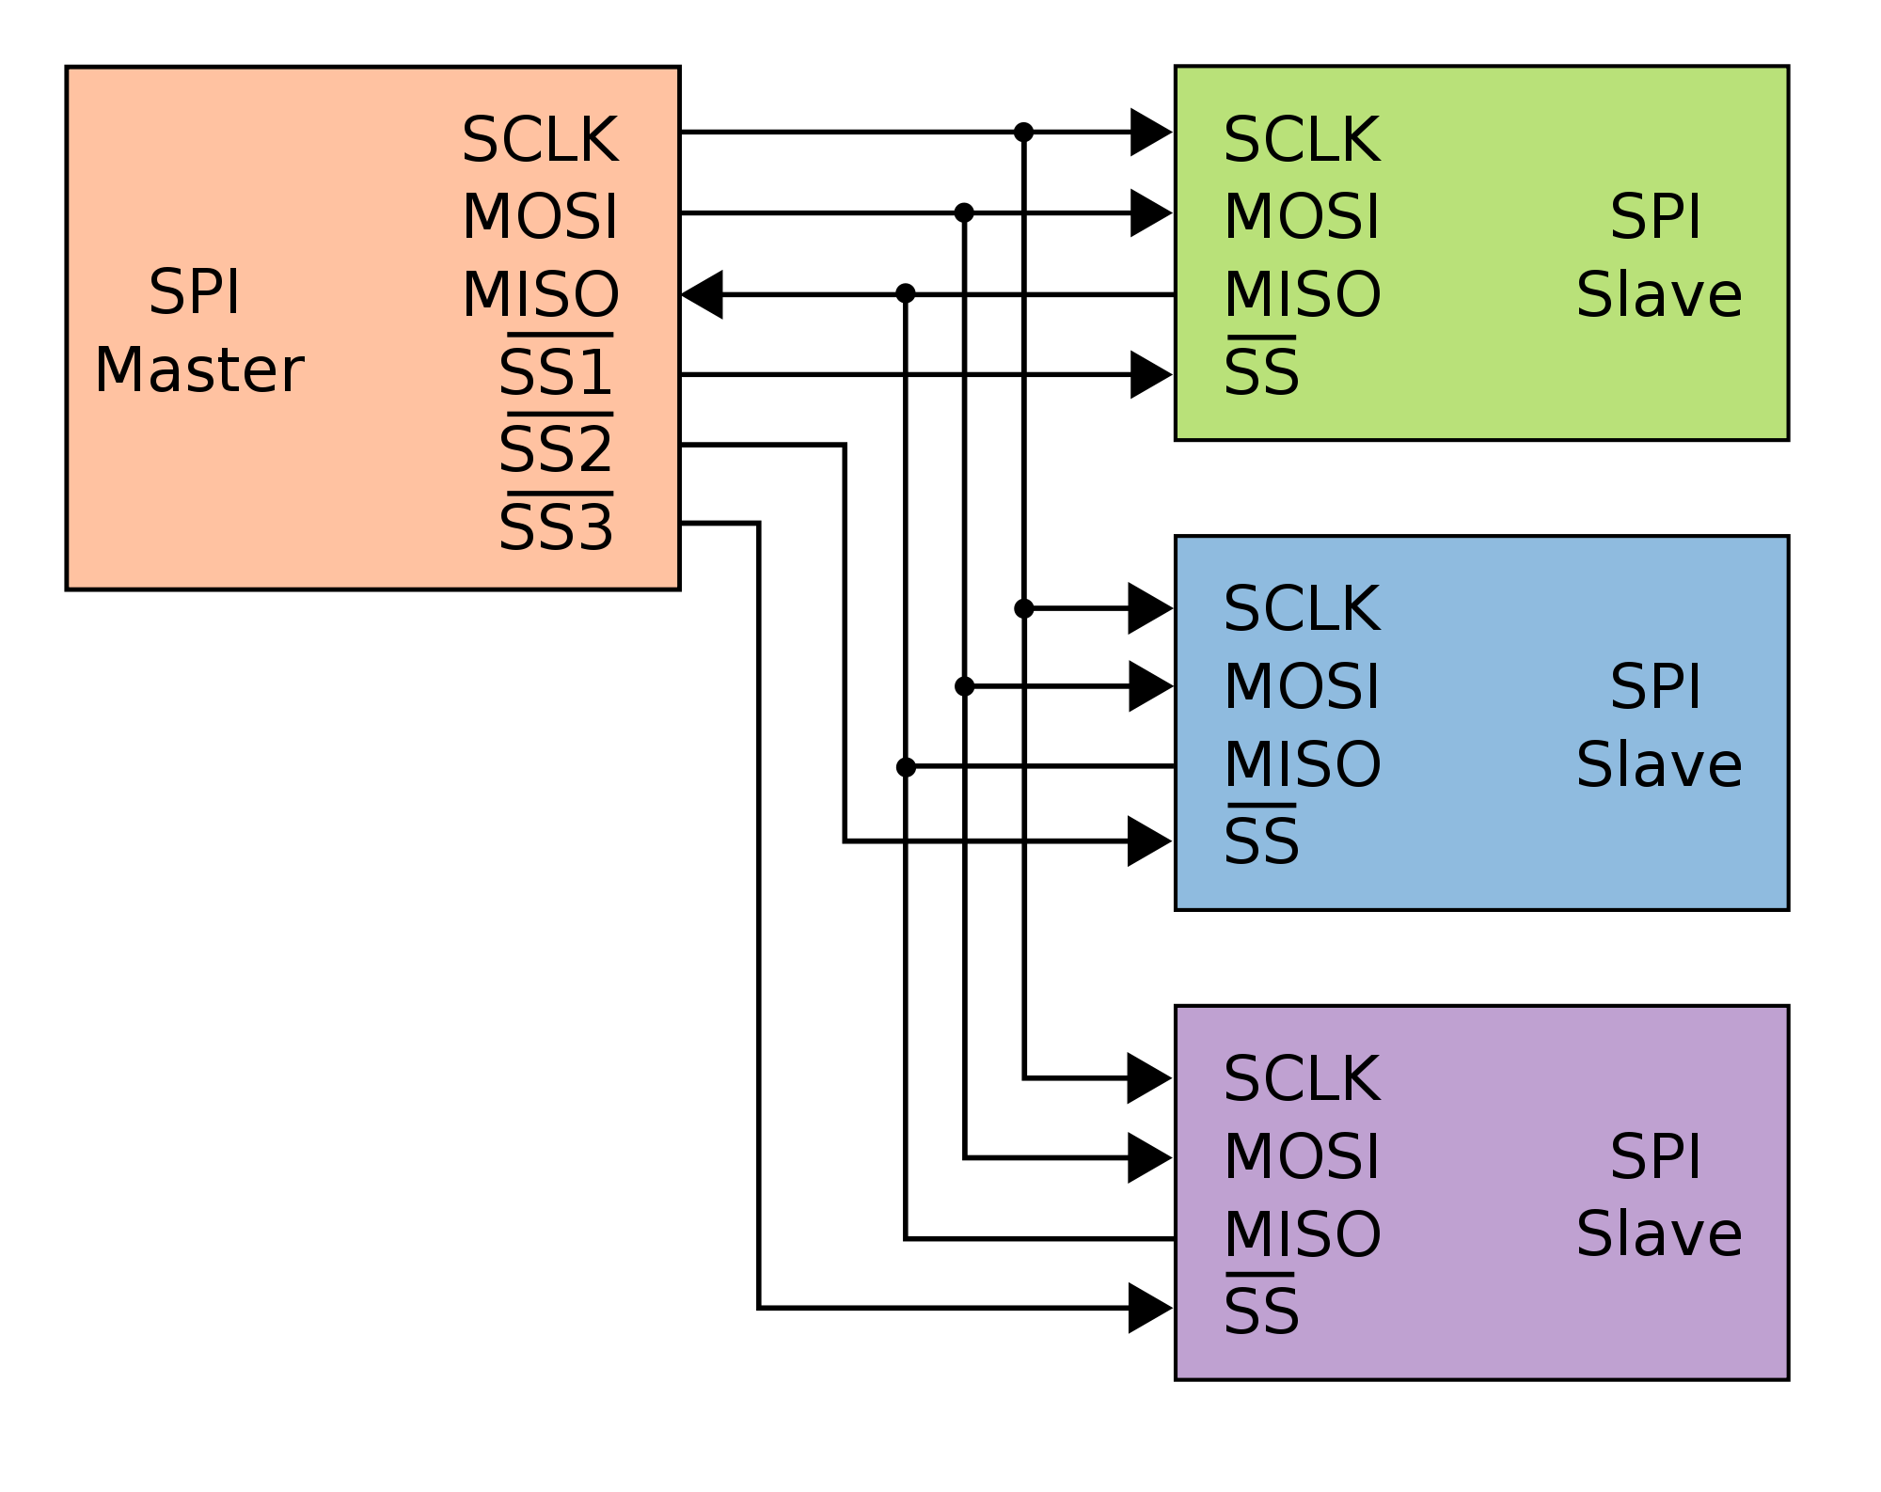
SPI Protocol
Wires:
Master Out Slave In (MOSI)
Master In Slave Out (MISO)
System Clock (SCLK)
Slave Select 1…N
Master Set Slave Select low
Master Generates Clock
Shift registers shift in and out data

Slide 28
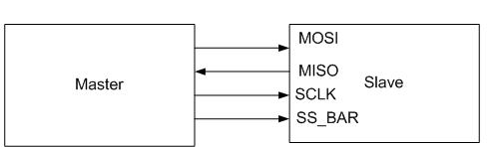
SPI Wires in Detail
MOSI – Carries data out of Master to Slave
MISO – Carries data from Slave to Master
Both signals happen for every transmission
SS_BAR – Unique line to select a slave
SCLK – Master produced clock to synchronize data transfer

Slide 29
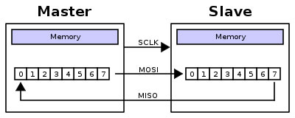
SPI uses a “shift register” model of communications
Master shifts out data to Slave, and shifts in data from Slave
http://upload.wikimedia.org/wikipedia/commons/thumb/b/bb/SPI_8-bit_circular_transfer.svg/400px-SPI_8-bit_circular_transfer.svg.png

Slide 30
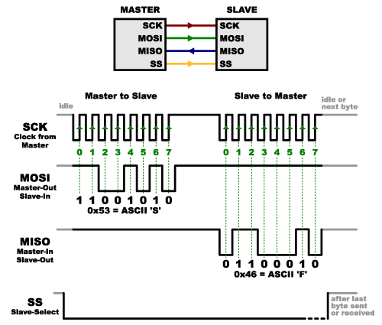
SPI Communication

Slide 31
SPI clocking: there is no “standard way”
Four clocking “modes”
Two phases
Two polarities
Master and selected slave must be in the same mode
During transfers with slaves A and B, Master must
Configure clock to Slave A’s clock mode
Select Slave A
Do transfer
Deselect Slave A
Configure clock to Slave B’s clock mode
Select Slave B
Do transfer
Deselect Slave B
Master reconfigures clock mode on-the-fly!

Slide 32
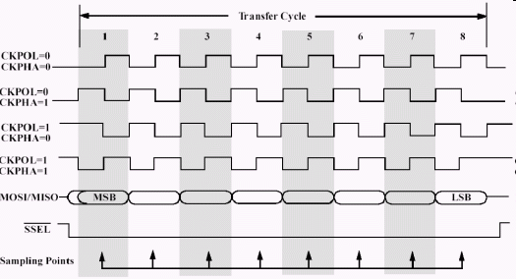
SPI timing diagram
Timing Diagram – Showing Clock polarities and phases
http://www.maxim-ic.com.cn/images/appnotes/3078/3078Fig02.gif

Slide 33
SPI Pros and Cons
Pros:
Fast and easy
Fast for point-to-point connections
Easily allows streaming/Constant data inflow
No addressing/Simple to implement
Everyone supports it
Cons:
SS makes multiple slaves very complicated
No acknowledgement ability
No inherent arbitration
No flow control

Slide 34
I2C bus in our projects
Communication with the accelerometer
Read from the accelerometer
Pros
Simple wire connection
Two wires bus that can connect multiple peripherals with the MCU
Cons
Complexity is significantly higher

Slide 35
How to operate the camera?
Accel
I2C
register 1
register 2
….
MCU
I2C
Springs
https://www.youtube.com/watch?v=eqZgxR6eRjo

Slide 36
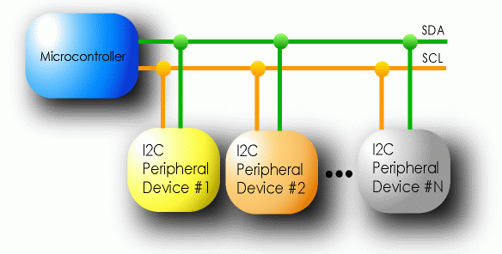
I2C Details
Two lines
Serial data line (SDA)
Serial clock line (SCL)
Only two wires for connecting multiple devices

Slide 37
I2C Details
Each I2C device recognized by a unique address
Each I2C device can be either a transmitter or receiver
I2C devices can be masters or slaves for a data transfer
Master (usually a microcontroller): Initiates a data transfer on the bus, generates the clock signals to permit that transfer, and terminates the transfer
Slave: Any device addressed by the master at that time

Slide 38
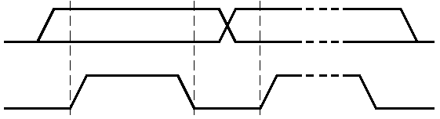
Bit Transfer on the I²C Bus
In normal data transfer, the data line only changes state when the clock is low
SDA
SCL
Data line stable; Data valid
Change of data allowed

Slide 39
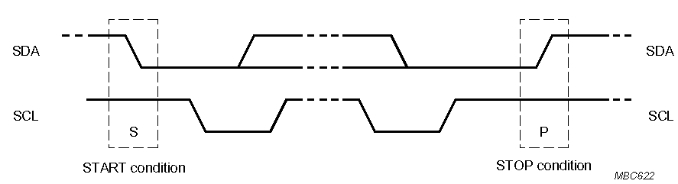
Start and Stop Conditions
A transition of the data line while the clock line is high is defined as either a start or a stop condition.
Both start and stop conditions are generated by the bus master
The bus is considered busy after a start condition, until a stop condition occurs
SDA
SDA
SCL
SCL
Start Condition
Stop Condition

Slide 40
I²C Addressing
Each node has a unique 7 (or 10) bit address
Peripherals often have fixed and programmable address portions
Addresses starting with 0000 or 1111 have special functions:-
0000000 Is a General Call Address
0000001 Is a Null (CBUS) Address
1111XXX Address Extension
1111111 Address Extension – Next Bytes are the Actual Address

Slide 41
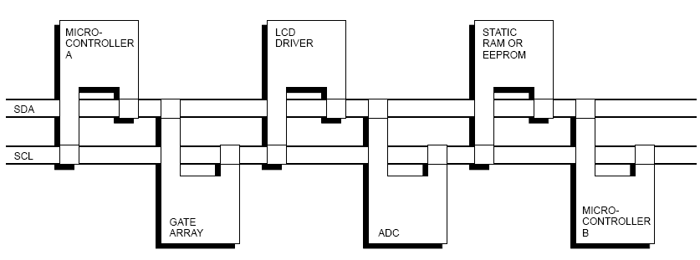
I2C-Connected System
Example I2C-connected system with two microcontrollers
(Source: I2C Specification, Philips)

Slide 42
Master-Slave Relationships
Who is the master?
master-transmitters
master-receivers
Suppose microcontroller A wants to send information to microcontroller B
A (master) addresses B (slave)
A (master-transmitter), sends data to B (slave-receiver)
A terminates the transfer.
If microcontroller A wants to receive information from microcontroller B
A (master) addresses microcontroller B (slave)
A (master-receiver) receives data from B (slave-transmitter)
A terminates the transfer
In both cases, the master (microcontroller A) generates the timing and terminates the transfer

